Slide 1
BABASAHEB BHIMRAO AMBEDKAR UNIVERSITY VIDYA VIHAR, RAEBARELI ROAD, LUCKNOW-226025 Department of Computer Science Presentation of Mini Project – Delta Game Submitted by Submitted to Mohd Talib Dr. Deepa Raj Mam Class - Mca Prof. Shishir Kumar Sir Semester - IVth Roll No. – 200821

Slide 2
Title Of Project
Delta Game
Tools Used In Project:-
Concept/Subject | Software/Tools
HTML | Visual Studio Code Editor and Chrome Browser
CSS | Visual Studio Code Editor and Chrome Browser
Java Script | Visual Studio Code Editor and Console Window of Chrome Browser

Slide 3
Delta Game project is developed using HTML, CSS, and JavaScript. The game play of this project is similar to the space shooter game. Here the player has to dodge and shoot the enemies using Keyboard controls (Arrow Keys for movement and Space Bar to Shoot) in order to gain score points. The enemy comes and shoots randomly forming different shapes. There are maximum three lives of the player’s spaceship. Now talking about the environment, the game is based on outer space and the asteroids are also set in the gaming environment. For the development of this simple web-based gaming project, different Images, scripts, sounds are used to bring the final output. All the gaming function is set from Java script whereas HTML and CSS are set for the layouts and other minor functions. To run this project, we recommend you to use Modern browsers such as Google Chrome.

Slide 4
Objective Of Project:- Delta Game is a single player shooter game that has kept us busy to shoot enemies and the enemy comes and shoots randomly forming different shape. This video game has made several fans.

Slide 5
First Level Data Flow Diagram(DFD):-
Move to Left Start and Shoot Move to Right
Move to Up Move to Down
Left Arrow
Spacebar
Right Arrow
Delta Game
Up Arrow
Down Arrow

Slide 6
Second Level Data Flow Diagram(DFD):-
No Yes
Move to Left Start and Shoot
Move to Right
Move to Up Move to Down
Left Arrow
Spacebar
Right Arrow
Delta Game
Up Arrow
Down Arrow
If life is collides to any images.
Score++
Stop
Exit

Slide 7
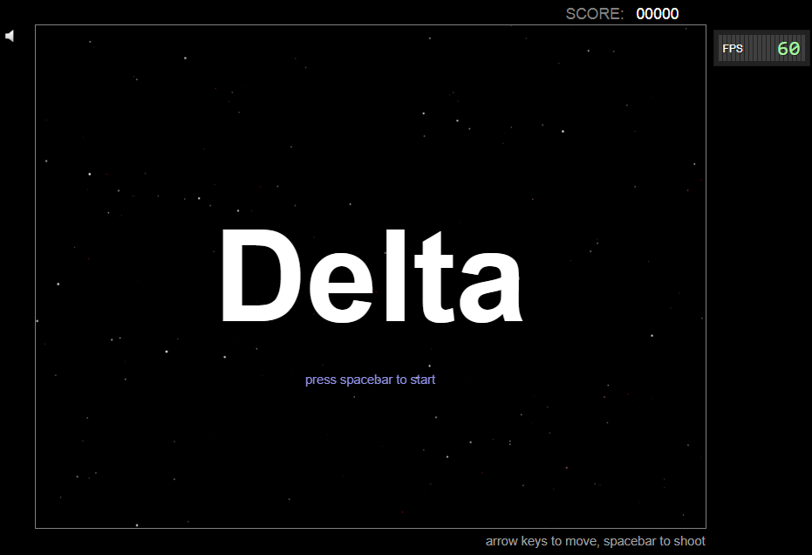
Screenshots Of Delta Game:-

Slide 8
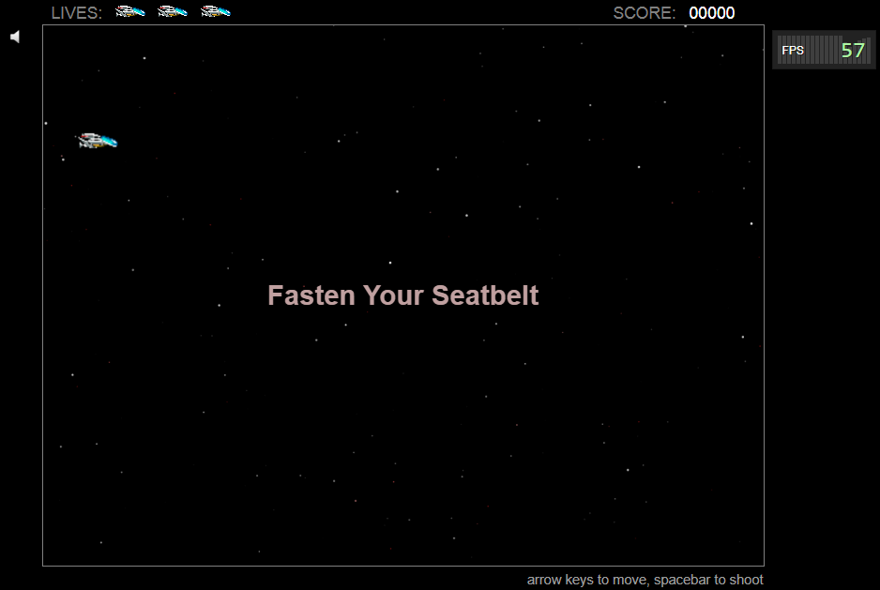

Slide 9
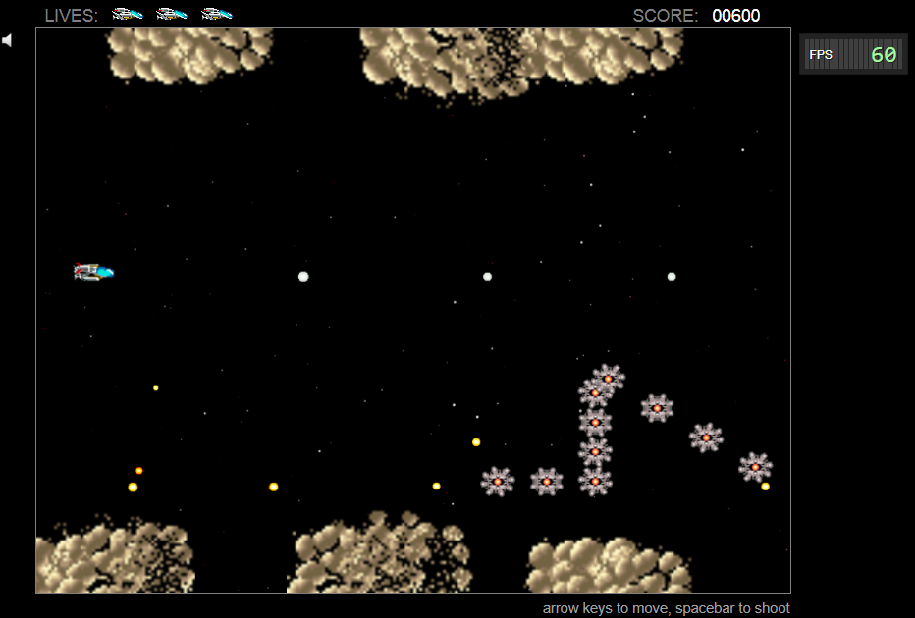

Slide 10
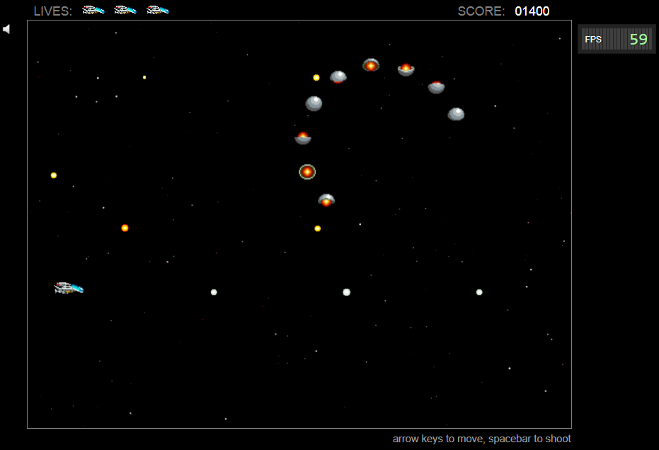

Slide 11
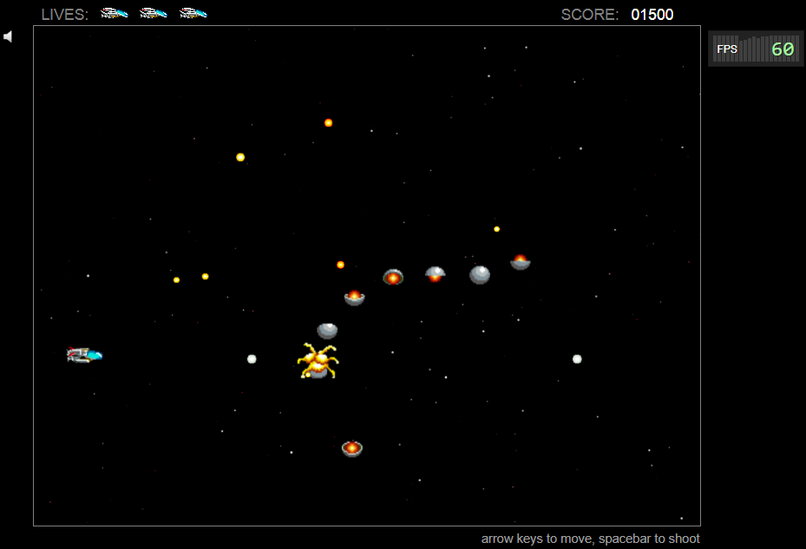

Slide 12
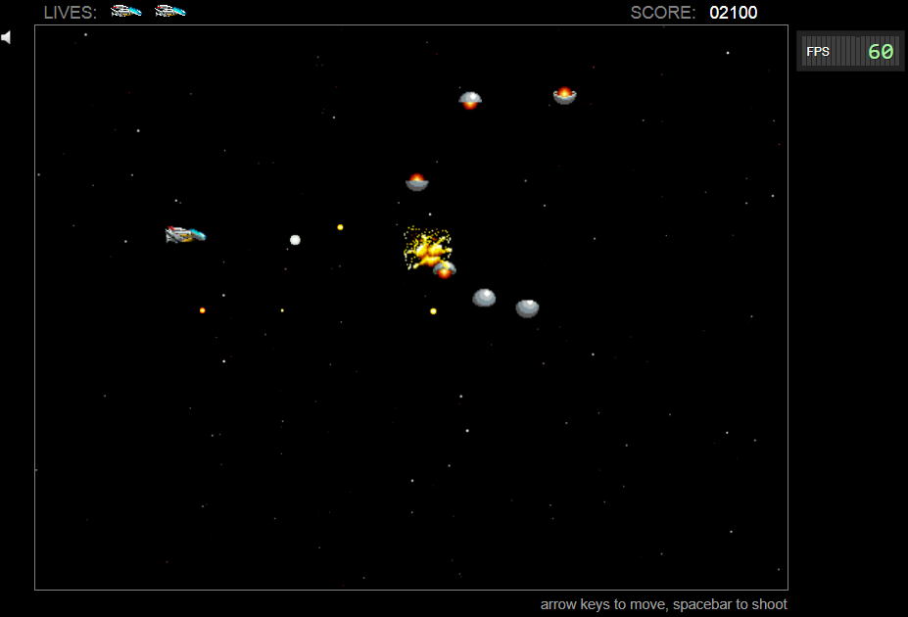

Slide 13
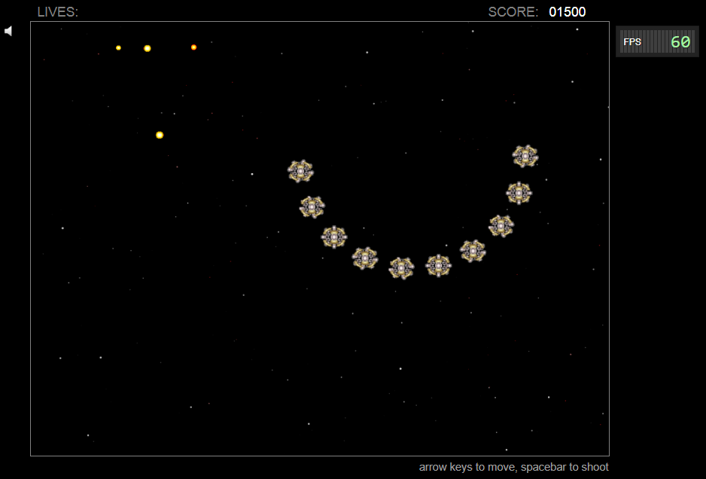

Slide 14
Thank You Presented By – Mohd Talib

